Slide 1

MediSyn/BRIDGE
Group 2:
Sajan Kumar Kar Parv Bhargava

Slide 2
IDEA
Interprofessional Education (IPE) is a collaborative approach that brings together students from various disciplines to learn collaboratively, aiming to enhance teamwork.
Interprofessional Practice (IPP) is putting it into practice.
BRIDGE delves into building a Multi-Agent chatbot system capable of simulating educational conversations representing diverse professions in the medical and public health setting.
MediSyn is a multi-agent system that processes a patient's IPE case study, retrieves the appropriate healthcare roles, and generates individualized treatment plans from each profession's perspective.

Slide 3
Current Issues
Scheduling: Different people have different logistics, making it hard to find time for joint sessions.
Financial constraint: Coordinating IPE requires extra funds for things like faculty time, simulation tools, and shared spaces.
Cultural Barriers: Stereotypes and hierarchical power imbalances between professions can block effective teamwork.

Slide 4
OVERVIEW
MediSyn
Data about healthcare IPP patient cases
Build Multi-agent system that extracts 'Team Members' and builds catered IPP treatment plan by the various team members who are healthcare professionals from various disciplines.
BRIDGE
Specific private case studies
Build Multi-agent system, that has specific agents from various disciplines, to facilitate IPE.
Build a website for customer use.

Slide 5
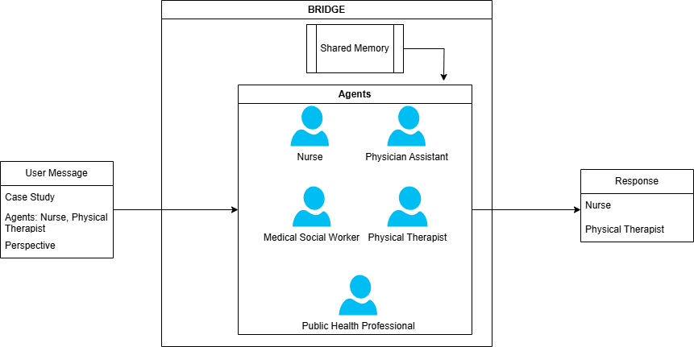
BRIDGE- Architecture

Slide 6
BRIDGE- Professions
Agents:
Nurse
Physician Assistant
Medical Social Worker
Physical Therapist
Public Health Professional
The idea is that given a patient's case study, these agents should be able to substitute for professionals and help collaborate and facilitate learning by being able to answer various questions regarding the case.

Slide 7
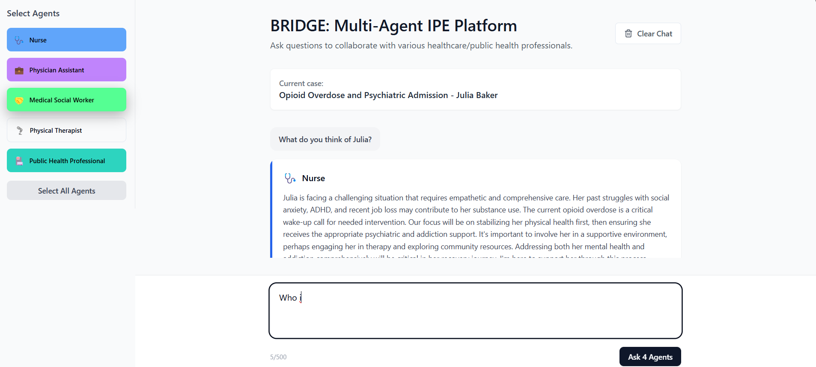



BRIDGE Webapp

Slide 8
MediSyn
MediSyn is a multi-agent system that generates a role-specific IPP treatment plan for a patient's case.
Existing AI chatbots typically generate treatment plans from a single-provider perspective.
They lack role-specific care that's needed for patient's care in IPE.
Goals:
Where a multi-agent system like MediSyn fits in the broader landscape of AI-assisted treatment planning
How it compares to single-agent (single-role) systems and prompt tuned

Slide 9
MediSyn: Process
Convert all the data from PDFs to Stuctured JSONs
Pass the Data to LLM & Multi-Agent System to generate Agent specific Treatment Plan representative of Profession Specific Treatment Plan
Compare results generated from single LLM vs. Multi-age
Evaluate performance using metrics (BLEU, ROUGE score, etc.)

Slide 10
MediSyn: Data Extraction
Extract text from structured PDF using UNSTRUCTURED
System Prompt instructs LLM to extract relevant fields
LLM is invoked to parse response and save to JSON
We also do a manual extraction of the data to have a JSON ground truth dataset

Slide 11

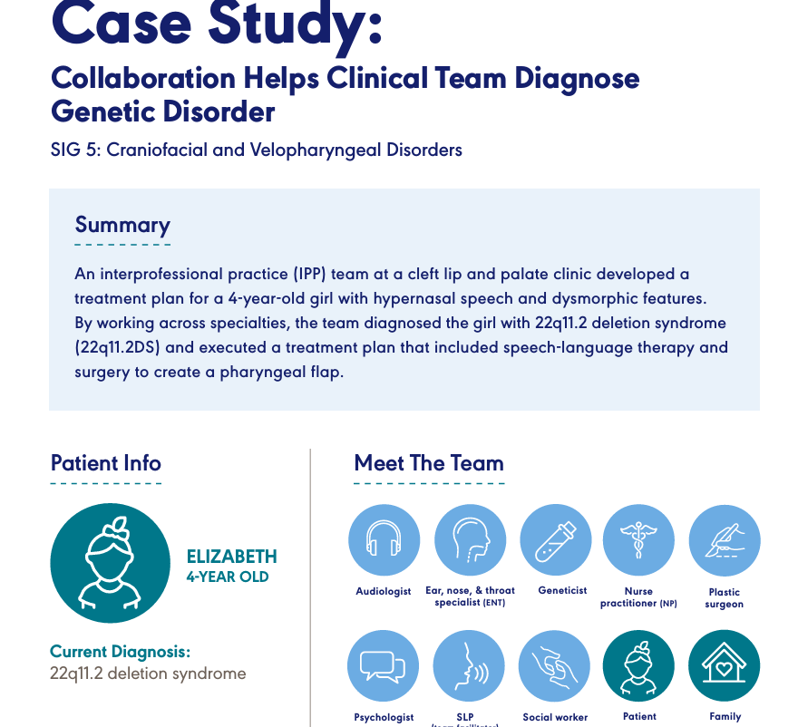
MediSyn: Raw Data
Data: PDFs with the patient case, IPP team members, assessment plans and results, IPP treatment plans.
15 case studies used.

Slide 12
MediSyn: Extracted Data
Field | Description
Patient_info | Includes patient's name, age, diagnosis
Summary | Summary of the case
Team_members | List of involved professionals
Background | Patient's background
Assessment_plan | Evaluation responsibilities assigned to each professional
Assessment_results | Results of the diagnostic evaluations
Treatment_plan | Final IPP treatment plan co-developed by the team

Slide 13
MediSyn: Approaches
LLMs:
LLLAMA 3.2 70b
Claude 3.5 sonnet
GPT 4o
Baseline approach: Uses Single LLM with a simple prompt
Prompt-tuned Approach: Carefully crafted prompt to generate role specific treatment plan
MediSyn: Proposed Multi-agentic approach
We compare the results for both manually prepared data and LLM prepared Data

Slide 14
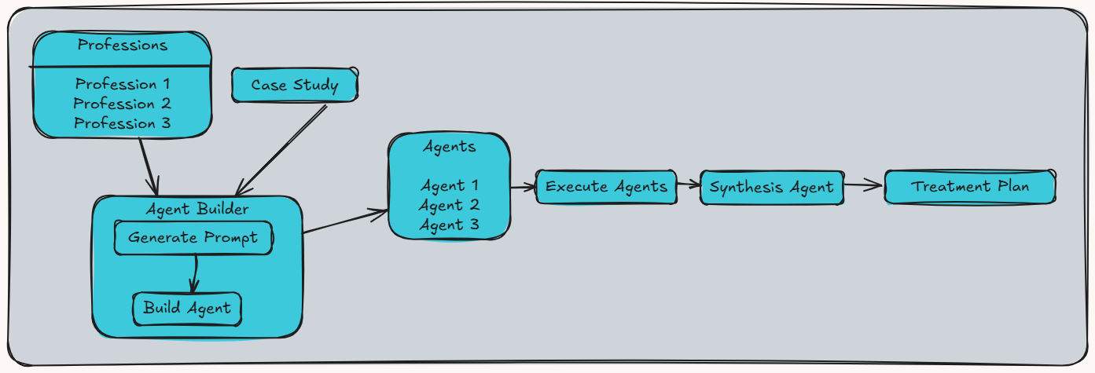
MediSyn: Architecture

Slide 15
MediSyn: Evaluation
Quantitative:
BLEU Score- Measures n-gram overlap between generated and reference treatment plans
ROUGE score- assesses how much of the reference plan content is captured in the generated plans
LLM-as-a-judge evaluation (GPT- 4o):
Accuracy
Plausibility
Specificity
Omission
Qualitative:
Manual reading of treatment plans (structure, role attribution, collaborative language)

Slide 16
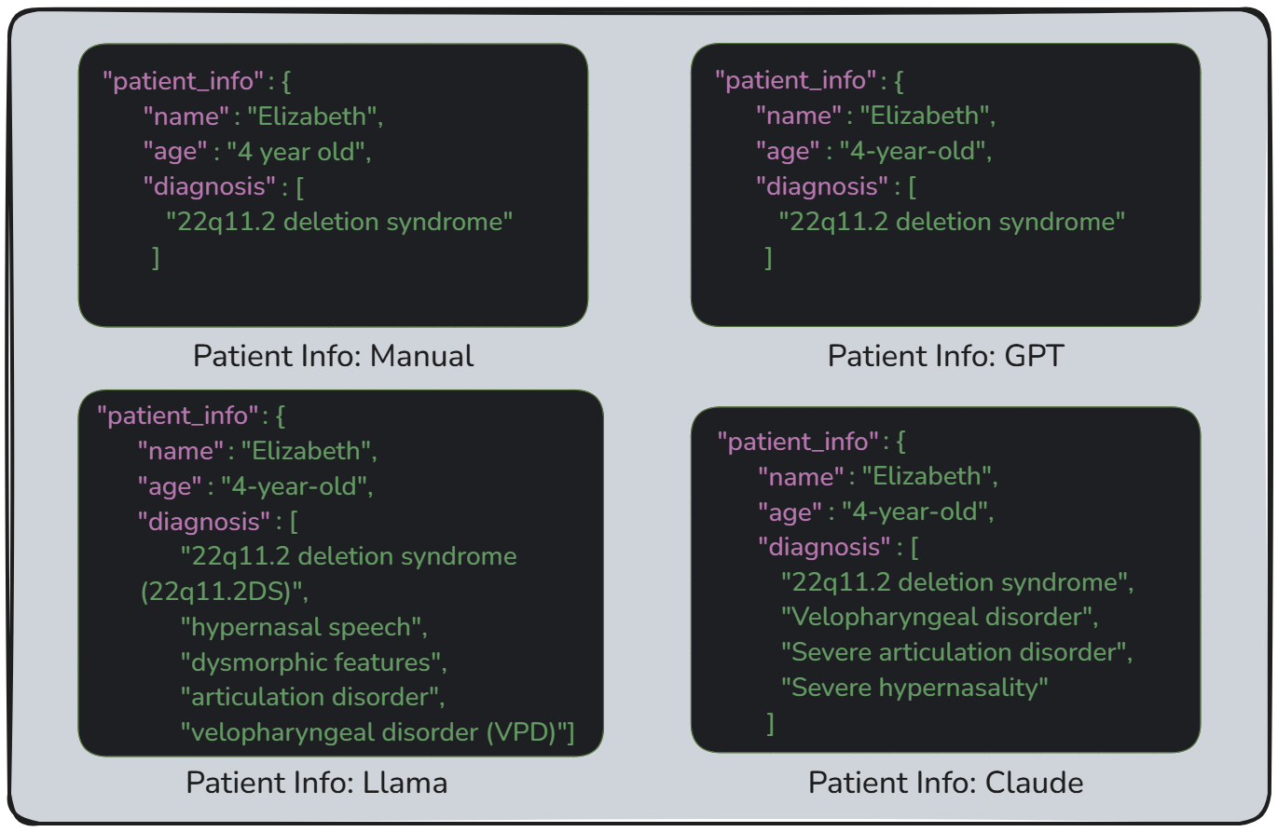
MediSyn: Results (Data Preparation)
GPT preserved the format closest to the manual version
Claude and Llama included additional conditions in diagnosis
Overall required data is captured
The case is similar in other fields: GPT stays true to exact data. Claude and Llama reformat into more prose-driven structure

Slide 17
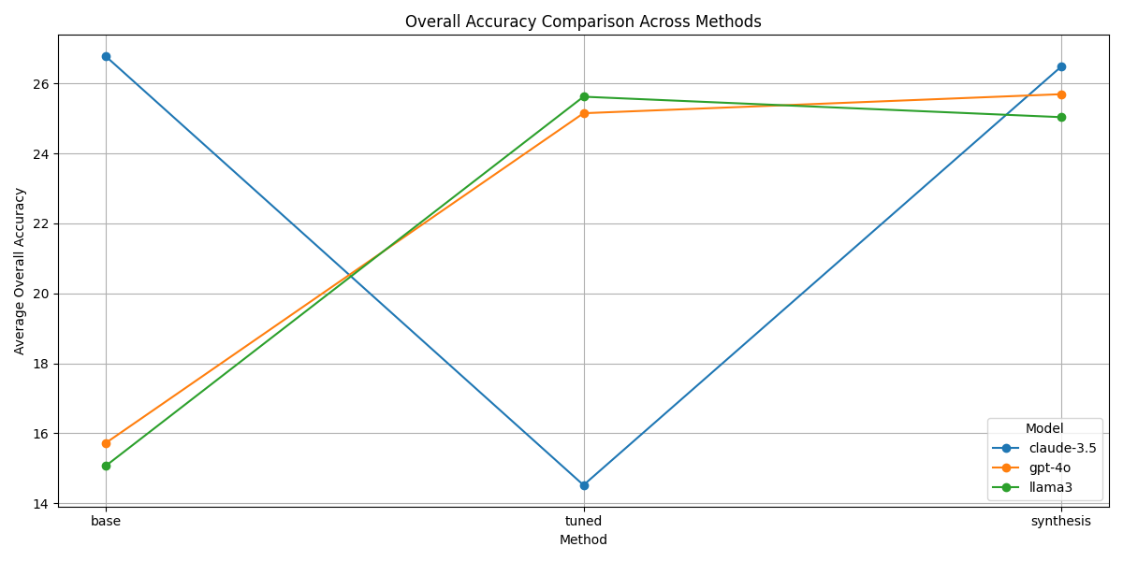
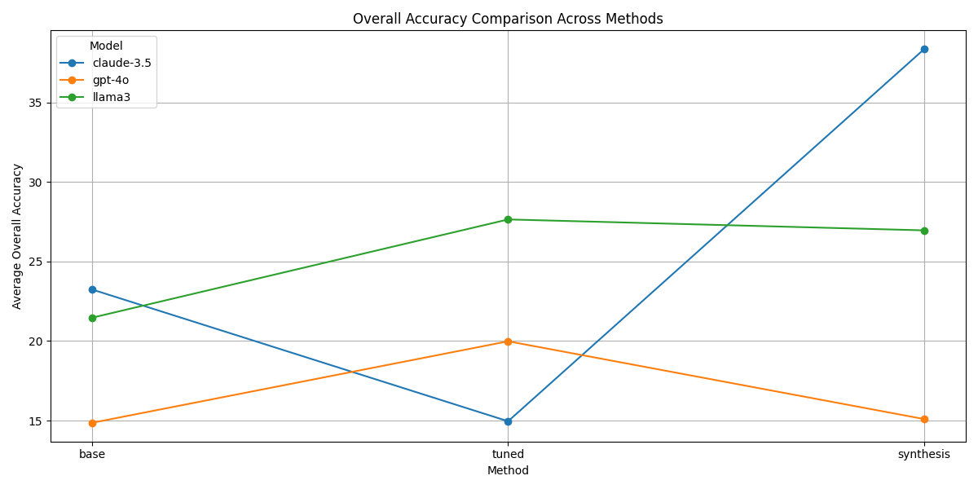
MediSyn: Results (Quantitative Analysis)
LLM-as-a-judge Overall Accuracy
Manual data consistently enhances overall accuracy
Claude performs best in MediSyn
Surprisingly, Claude prompt-tuned shows a massively low overall accuracy
Llama has highest accuracy in prompt-tuned version.
LLM data shows variable results
Claude performs best in MediSyn by a huge margin. Claude prompt-tuned drops from baseline here as well.
GPT and Llama show best accuracy in prompt-tuned version

Slide 18
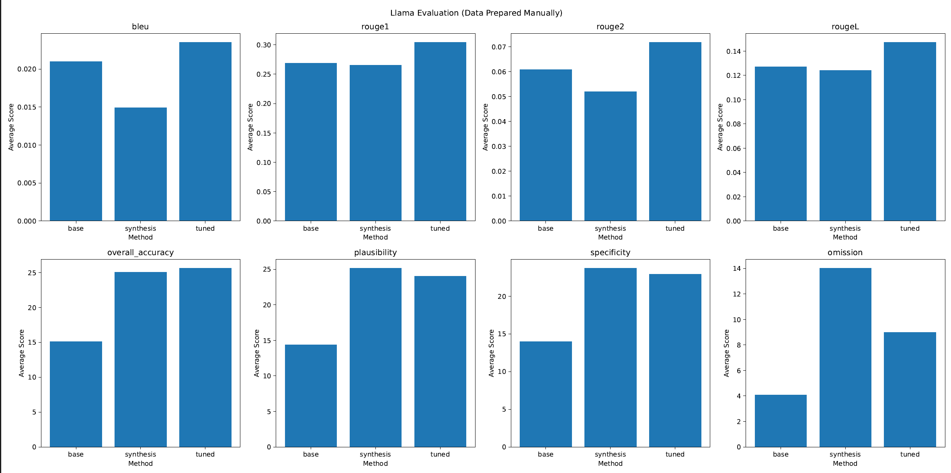
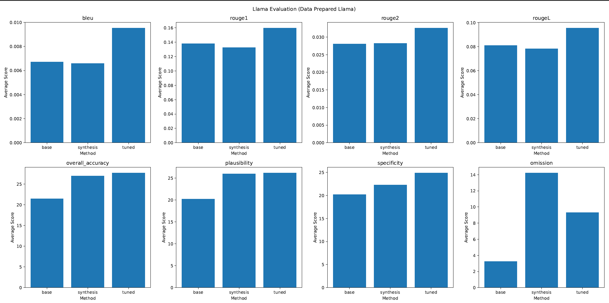
MediSyn: Results (Quantitative Analysis)
Manual
LLM - LLAMA
In terms of BLEU and ROUGE scores, prompt tuned version performs best for both.
In LLM-as-a-judge metrics, it's hard to choose between prompt-tuned & MediSyn

Slide 19
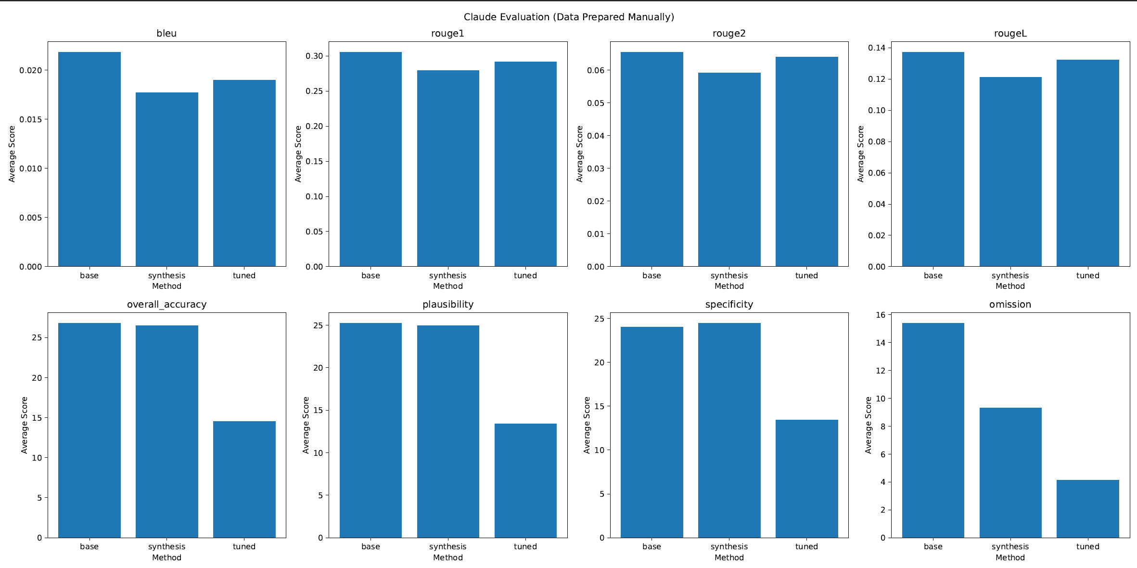
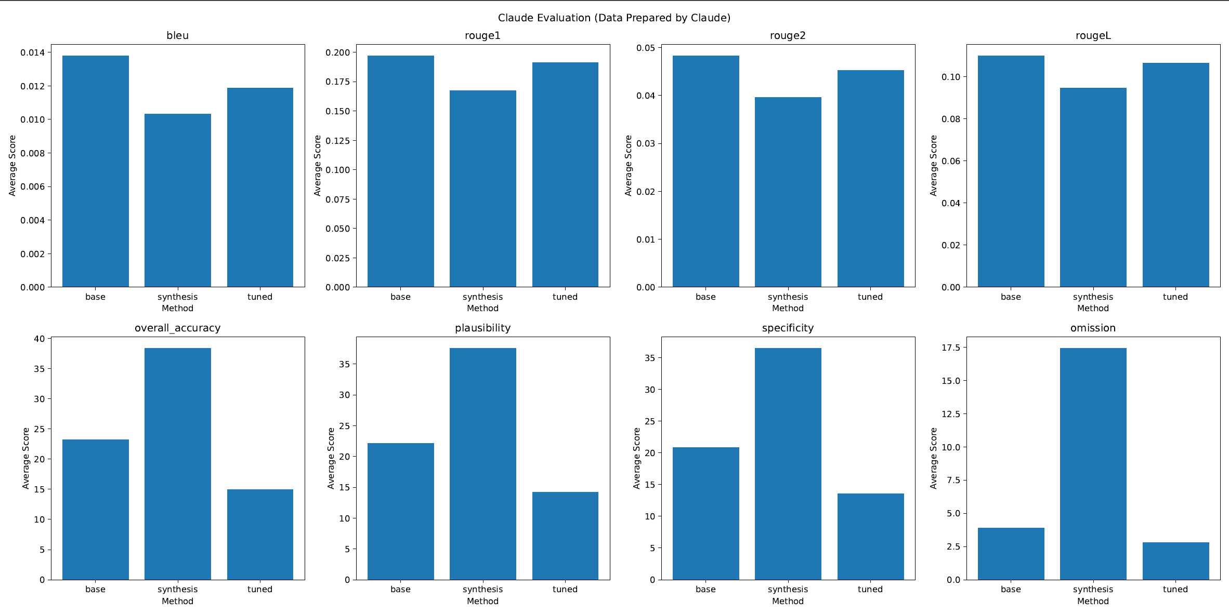
MediSyn: Results (Quantitative Analysis)
MANUAL
Llm - cLAUDE
In terms of BLEU and ROUGE scores, surprisingly, base model performs the best.
In LLM-as-a-judge metrics, for manual data preparation, it's hard to choose between base version and MediSyn
For LLM prepared data, MediSyn is the clear winner.

Slide 20
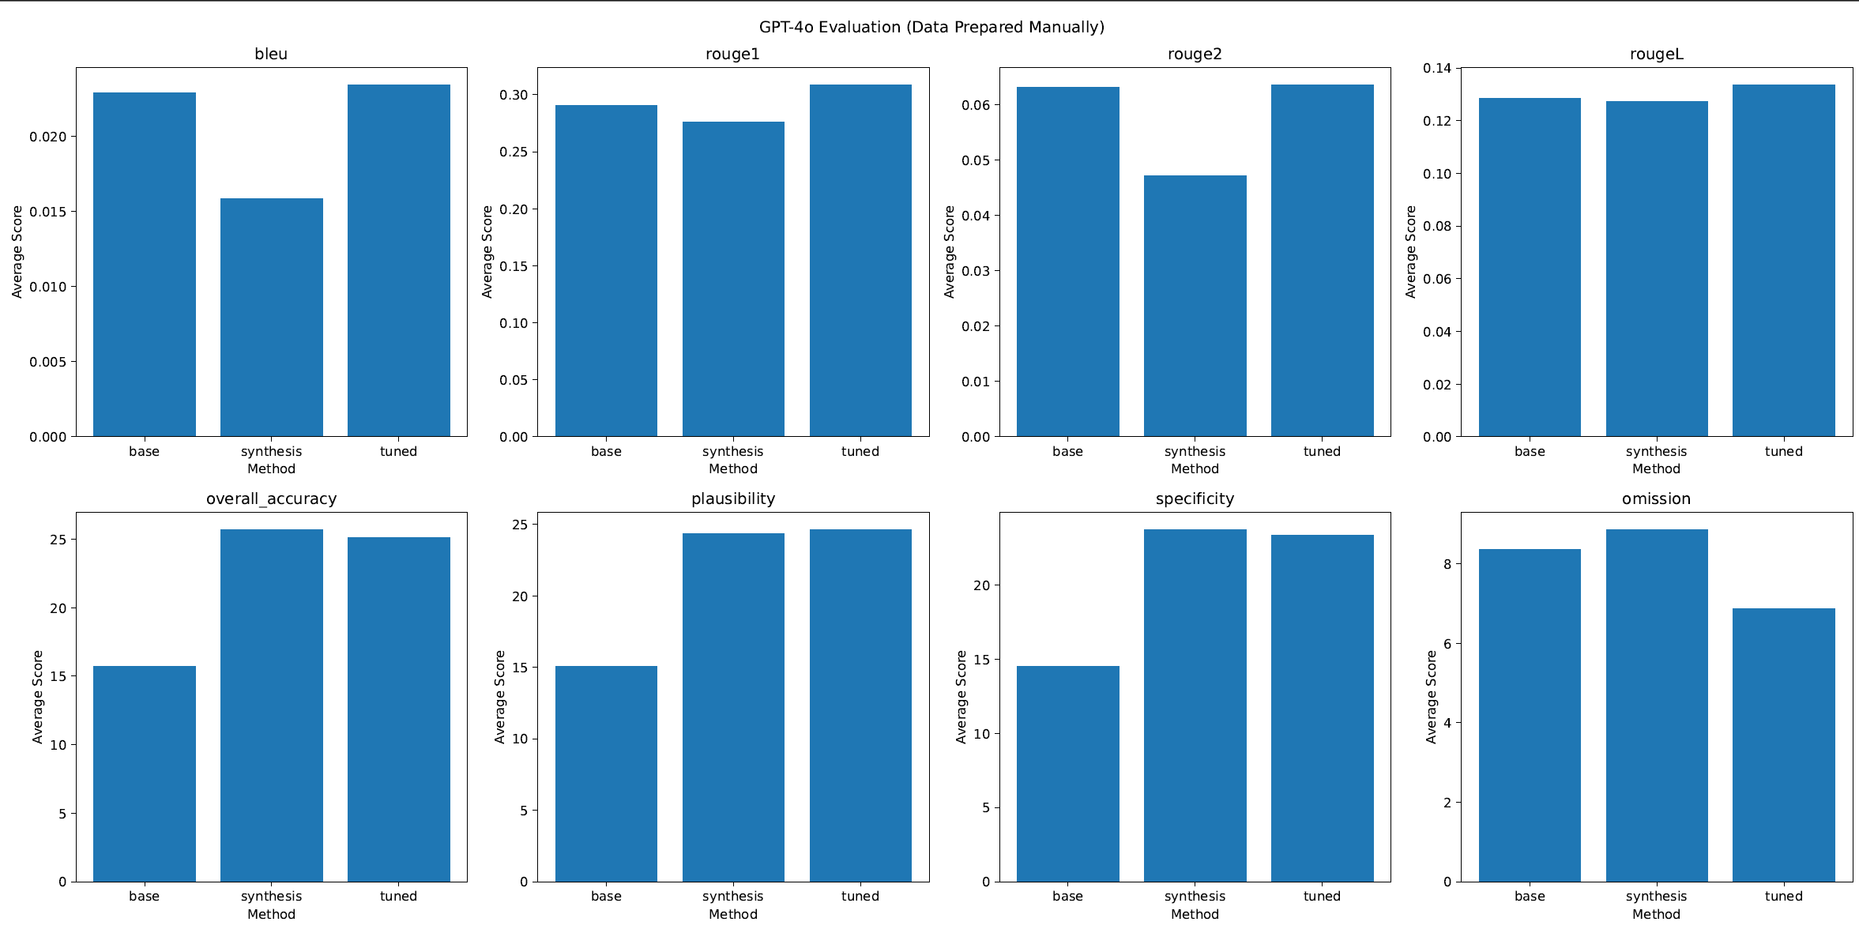
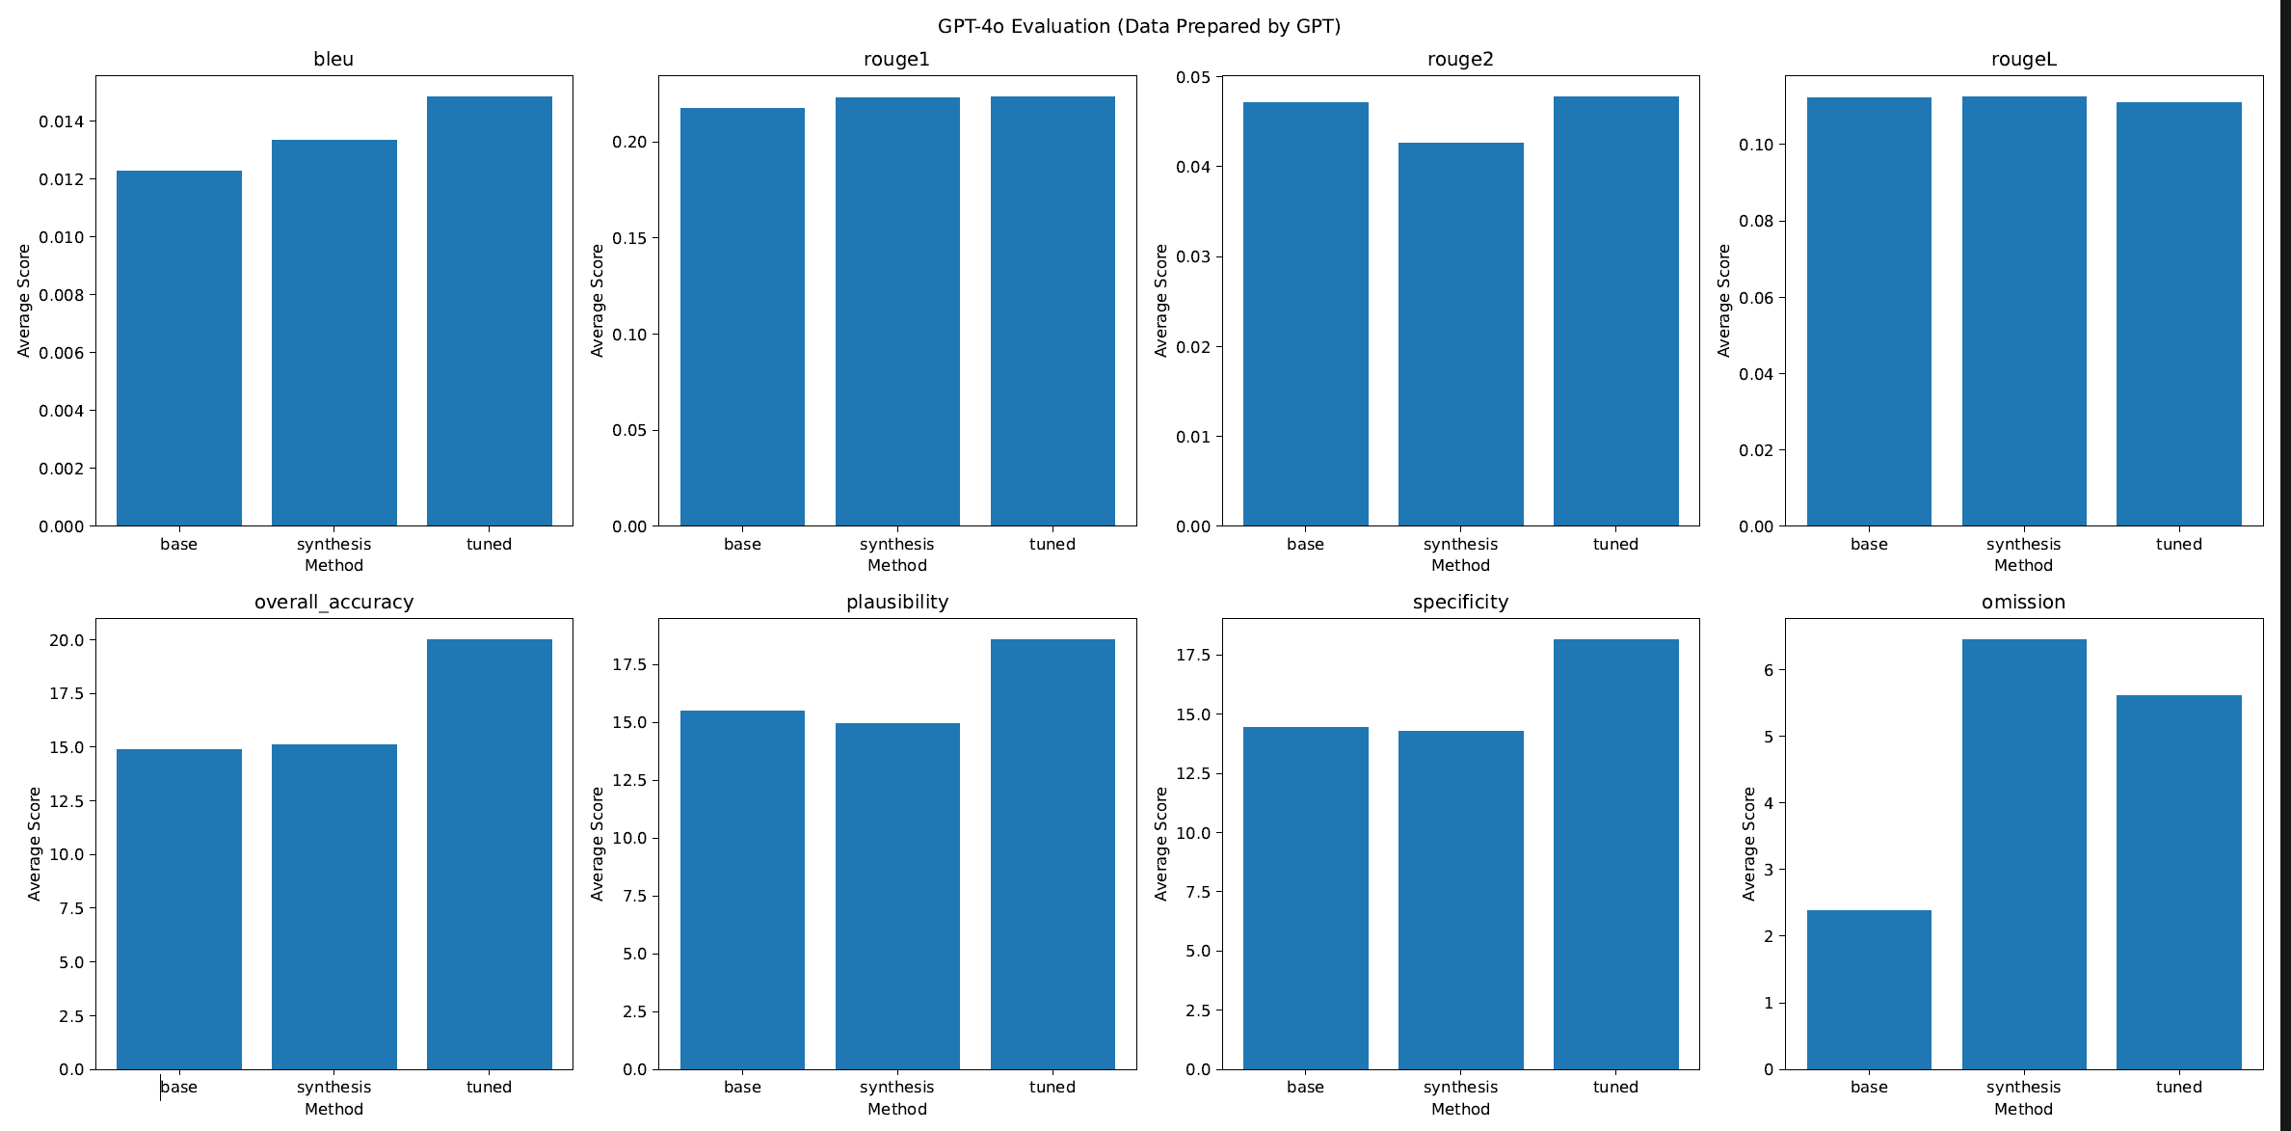
MediSyn: Results (Quantitative Analysis)
MANUAL
Llm - GPT4o
For BLEU and ROUGE scores, we see a drop in MediSyn's performance.
In LLM-as-a-judge, MediSyn is the best for manual data, while Prompt-tuning takes it for LLM data.

Slide 21
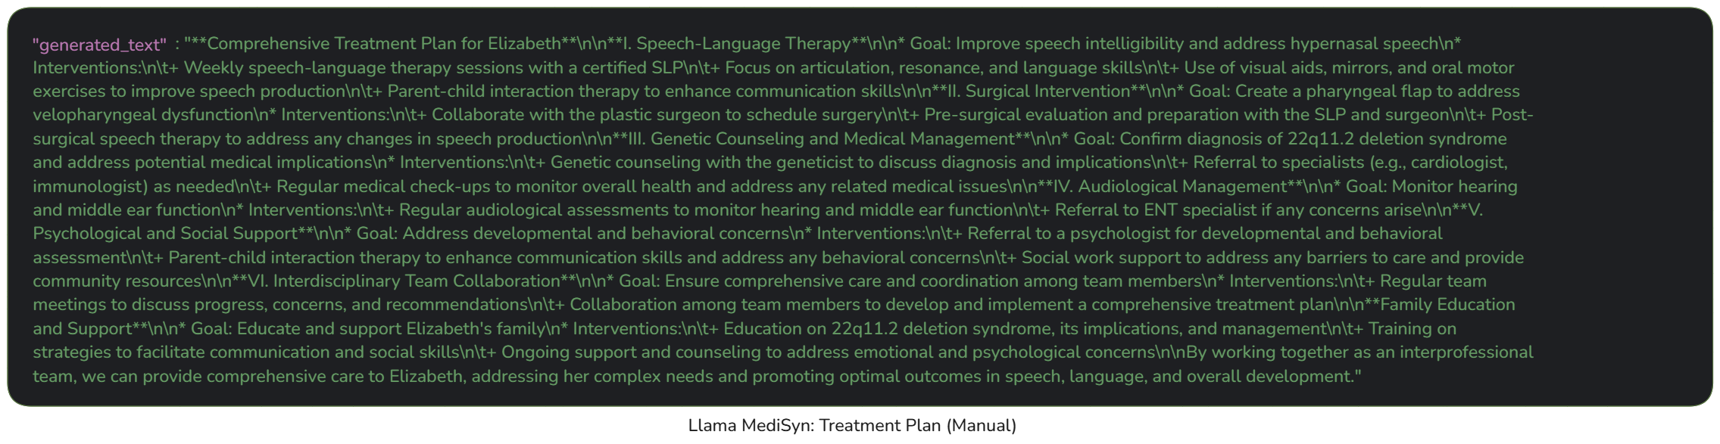

MediSyn: Results (Qualitative Analysis)
MANUAL Llama:
Baseline llama lacks role attribution and shows redundancy
Prompt-tuned improves clarity and IPE alignment with role specific structuring (best)
Medisyn gives polished but organized into discipline-based sections not individual roles
MANUAL Claude:
Baseline claude lacks role attribution; like a clinical summary
Prompt-tuning Improves role level clarity and IPE alignment, although verbose
Medisyn Claude improves cohesiveness and reduces verbosity (best)
MANUAL GPT:
Baseline is concise but lacks apt roles. Has roles like "frequency", "goals", "purpose".
Prompt-tuned response is quite good and hits all the checkmarks
Medisyn performs even better with better tonality and an addition of "Overall coordination and follow-up" (best)

Slide 22
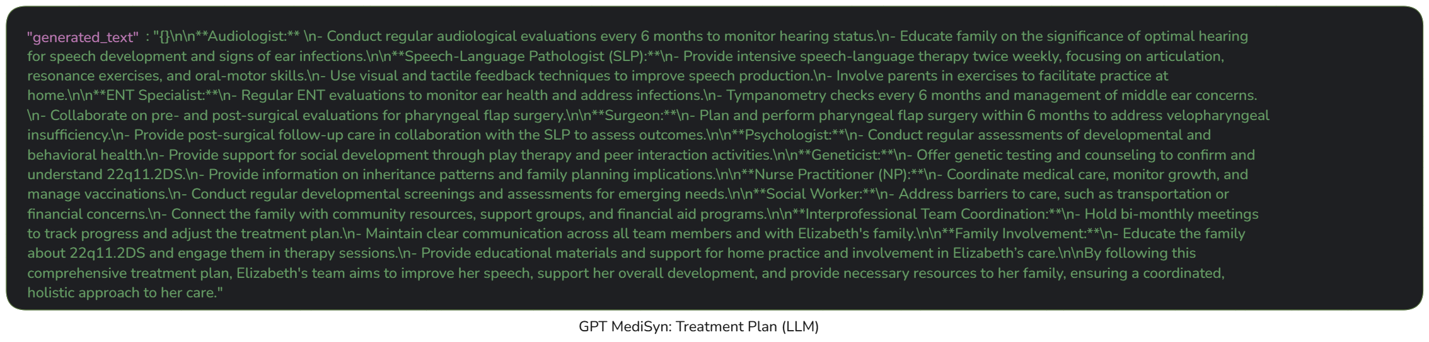
MediSyn: Results (Qualitative Analysis)
LLM Llama:
Baseline llama covered the core roles(SLP, Audiologist) but adds unnecessary sections ("Developmental Monitoring"); lacks nuance
Prompt-tuned shows clear roles
Medisyn gives structured, role-specific and comprehensive responses (some over-elaboration) (best)
LLM Claude:
Baseline claude lacks role segmentation
Prompt-tuning introduces roles although slightly redundant
Medisyn Claude is domain specific, has actionable strategies and collaborative, tone is empathetic (best)
LLM GPT:
Baseline lacks role-specificity; vague recommendations
Prompt-tuned response is role-specific but very compressed and non-elaborative
Medisyn gives great interprofessional depth, even combines overlapping roles to present singular solution (best)

Slide 23
Conclusion
Quantitative results are confusing and suggests that maybe just a prompt-tuning is sufficient.
Qualitative results make it clear that the Agentic system- MediSyn gives the best results.
To what extent should we rely on traditional quantitative metrics when evaluating clinical reasoning outputs, and when should human-aligned criteria take precedence?
In order to actually verify the treatment plan's efficiency, real human profession-specific analysis would be required.

Slide 24
THANKS

